Slide 1
SMART GARBAGE MONITORING SYSTEM
Under guidance of
Mr/Dr. MURUGAN R,
DEPARTMENT OF ECE,
BIT,
Sathy.
Student 1 (7376212AD178 & RAM KUMAR N)

Slide 2
ABSTRACT
Nonetheless, biodiversity is vanishing at a quicker rate than it has ever been throughout human history. One of the most pressing issues traditional methods of manually monitoring and management of trash. The spilling of rubbish is a sanitary hazard that could lead to diseases such as cholera, diarrhea, amoebic dysentery and dengue. Animals can starve if they consume too much plastic that they unable to digest. An automated waste management system. This is our IOT based garbage monitoring system, a novel approach to keeping cities clean and healthy. what we need are all part of the answer.
Key words: - Plastic, IOT, trash.

Slide 3
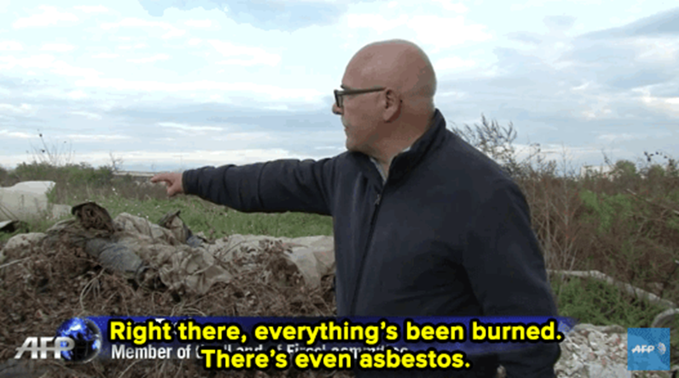
PROBLEM STATEMENT ADDRESSED
In the modern world, there are various accommodations that have been created in the rapidly expanding area.
The townships have had to deal with a number of difficulties.
One of them is solid waste disposal.In contrast to the villages, they employ a shared dustbin, which quickly fills up.
Furthermore, it is a waste of fuel to travel around places to determine whether the rubbish is completely filled or not.
Even yet, several towns are unaware of the harmful wastes created by large-scale enterprises, such as wasted acids, etchants, and other waste sludge.

Slide 4
EXISTING SOLUTION TO THE PROBLEM ADDRESSED
In addition to the smart trash bins that are presented in research context, there are also a few solutions on the market that are either commercially available or in testing phase.
It can also compress the trash that is collected inside the bin, using solar powered motors. While it is the most widely available smart trash bin that is on the market, high capital investment costs hinders it’s wider adoption.
The system presented in this paper differs from the above-mentioned smart waste management and collection solutions, mainly in terms of the design approach.
While there are a few commercially available solutions on the market, they are regarded as expensive and high-end solutions and their measured impact is yet to be reported.

Slide 5
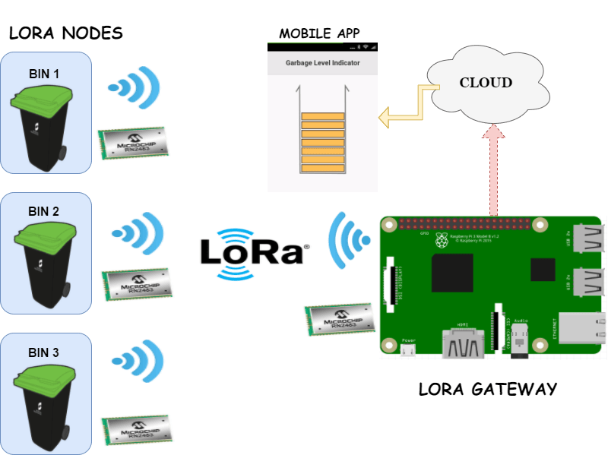
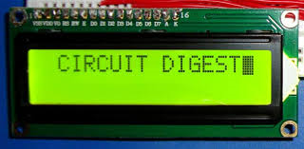
PROPOSED SOLUTION TO THE PROBLEM ADDRESSED
This is what we've come up with all of the power at our fingertips.
One of the major environmental challenges has been solid waste management, which has an impact on our society's health and environment.
This is an illustration of what may happen in the mind. Our solution to this problem includes a real-time measurement of the waste level in a trashcan.
To determine whether or not the garbage can is full, an Ultrasonic Sensor is used.
If the distance is less than this threshold value, it means that the trash can is full of garbage, and we will print the message "ALERT“, otherwise, we will print the message "NO NEED".

Slide 6
PROJECT WORK PLAN
ARDUINO MKR1000 :
The ARDUINO MKR1000 is a powerful board that combines the Zero with the features .
It is the appropriate choice for makers who want to develop Internet of things projects but have no networking experience.
ULTRASONIC SENSOR:
Operating voltage: +5V
Theoretical Measuring Distance: 2cm to 450cm
Accuracy: 3 milli meter
Measuring angle covered: <15°
Operating Current: <15milli amps
Operating Frequency: 40Hertz
Lo Ra MODULE:
Lo Ra transmission works on chirping which breaks chips at different moments in time and frequency to encode a symbol. The fact that Lo Ra broadcast migrates from one area to another area at a specific time may suggest one bit string versus another. As it is based on chirp spread spectrum. It uses chirp pulses to encode information on radio waves, similar to how dolphins and bats communicate!
HARDWARE IMPLEMENTATIONS :
The ultrasonic sensor and ARDUINO are connected in a fairly straightforward manner.
Connect the ARDUINO’S 5V and ground to the VCC and ground of the ultrasonic sensor.
Then connect the ultrasonic sensor's TRIG and ECHO pins to pins 11 and 12 of the ARDUINO,
respectively (you may use any other pin).
Connect the ARDUINO ‘S RX pin to the Lo Ra module's TX pin, and the ARDUINO’S TX pin to the RX pin of the Lo Ra module.
Connect the ARDUINO’S GND pin to the module's ground.
In addition, the Lo Ra module requires a 12v external power source.

Slide 7
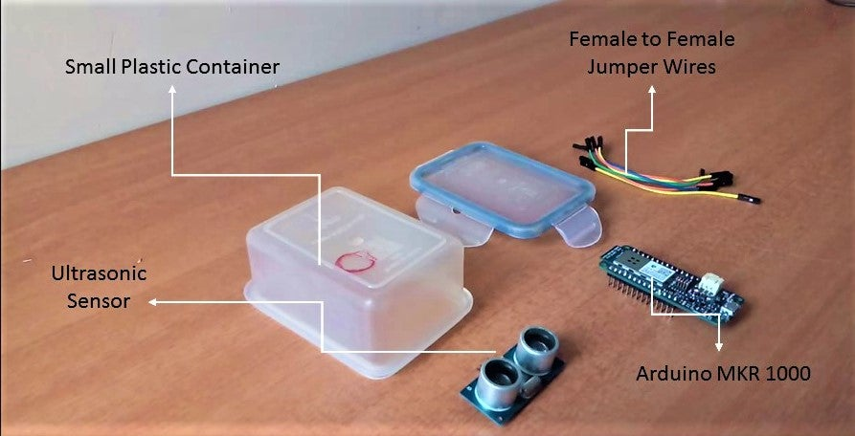
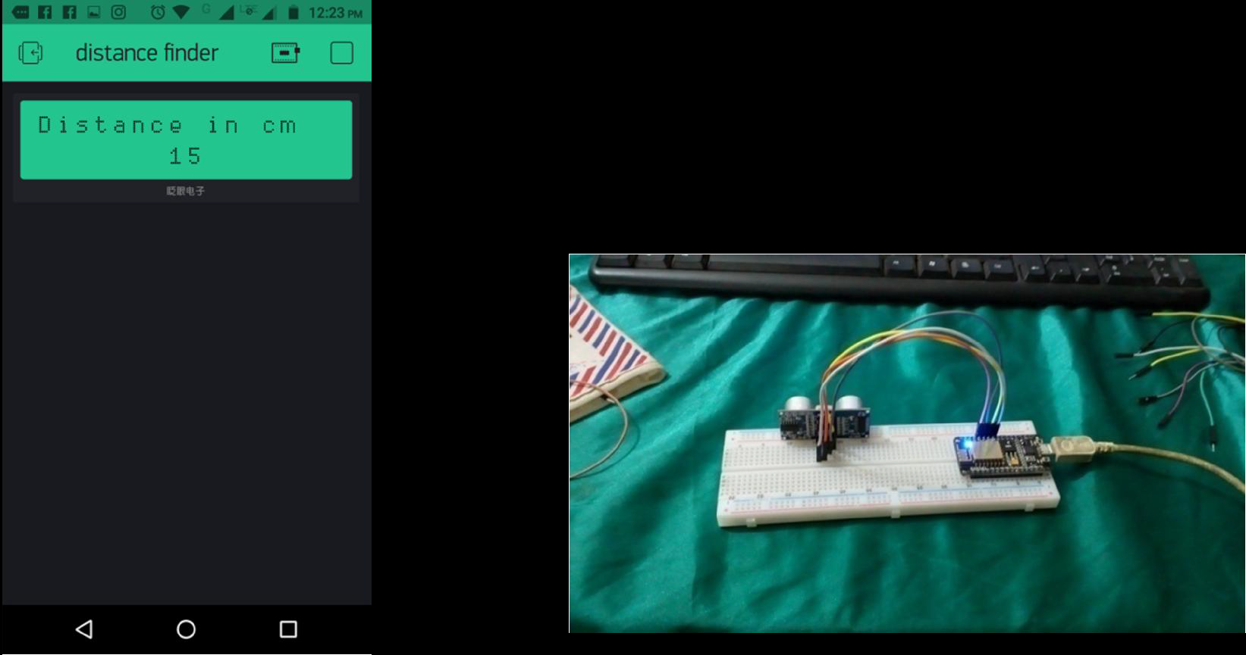
SOFTAWRE IMPLEMENTATION :
The software required for it is the ARDUINO IDE.
BLYNK :
It's compatible with Windows, Mac OS X, and Linux. environment is developed in
Java and is based on open source applications as Processing.
Any ARDUINO board may be used with this software.

Slide 8
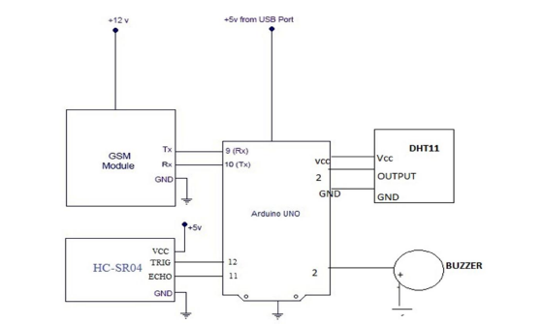
BLOCK DIAGRAM
LORA MODULE
Tx
Rx
GND

Slide 9
FLOW CHART
DUSTBIN
ULTRASONIC SENSOR
ARDUINO MKR 1000
Lo Ra module
TEMPERATURE AND HUMIDITY
DHT 11 SENSOR
Text message to mobile

Slide 10
EFFECTIVE UTILIZATION OF MODERN CLOUD & TOOL
Blynk is a Platform with iOS and Android apps to control Arduino, Raspberry Pi and the likes over the Internet .
It's a digital dashboard where you can build a graphic interface for your project by simply dragging and dropping widgets.
Blynk is not tied to some specific board or shield. Instead, it's supporting hardware of your choice.
Whether your Arduino or Raspberry Pi is linked to the Internet over Wi-Fi, Ethernet or this new ESP8266 chip, Blynk will get you online and ready for the Internet Of Your Things.
Blynk was designed for the Internet of Things. It can control hardware remotely, it can display sensor data, it can store data, visualize it and do many other cool things.

Slide 11
REASON :
Blynk App - allows to you create amazing interfaces for your projects using various widgets we provide.
Blynk Server - responsible for all the communications between the smart phone and hardware. You can use our Blynk Cloud or run your private Blynk server locally. It’s open-source, could easily handle thousands of devices and can even be launched on a Raspberry Pi.
Blynk Libraries - for all the popular hardware platforms - enable communication with the server and process all the incoming and out coming commands.

Slide 12
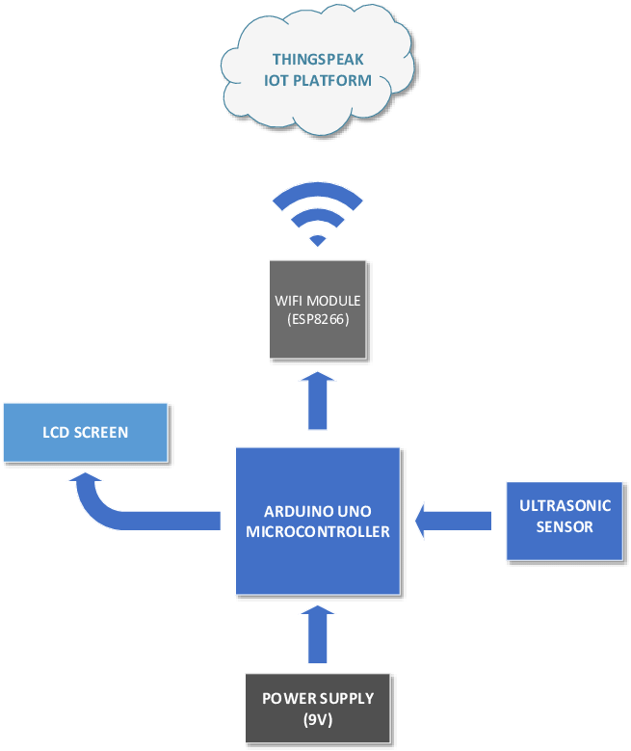
TECHNOLOGY AND STACK USE
MICRO CONTROLLER
RECEIVE
STATUS
SATAUS
UPTADE
POWER
SUPPLY
UV
SENSOR
DATA
PROCCESING
DATA
TRANSFER
MESSAGE
ALERT
GARBAGE CLEANING SERVICE PROVIDER

Slide 13
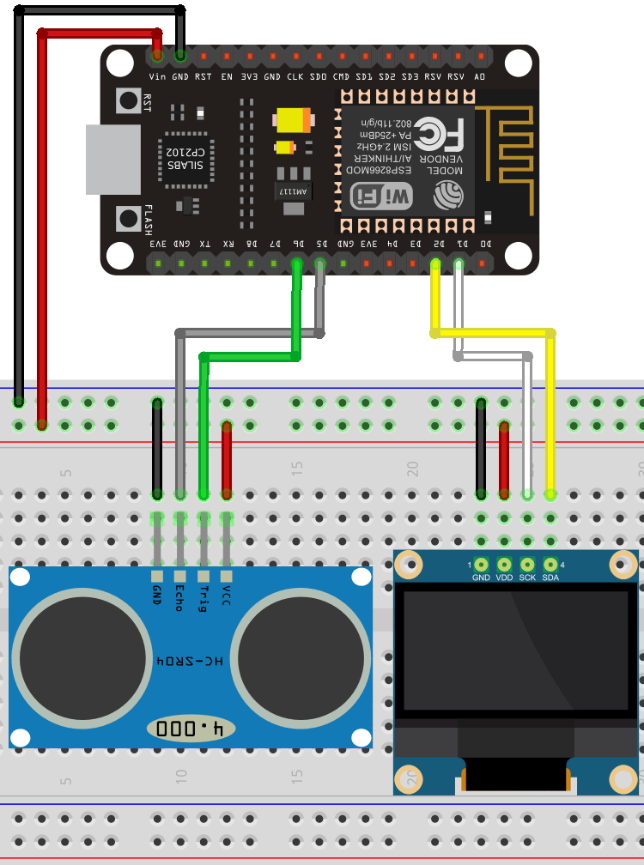
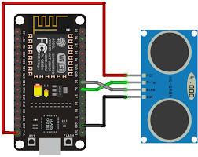
PROTOTYPE & SAMPLE OUTPUT

Slide 14
ANALYSIS OF RESULTS AND DISCUSSIONS
ADVANTAGES | DISADVANTAGES
Helps monitor garbage levels. | Only detects the top of the garbage level. It wouldn’t realize if there is space left.
Uses very small amount of electricity | The low bandwidth that permits its strengths.
Ultimately helps in better planning of garbage pickups. | Furthermore, due to constraints governing the frequency spectrum it uses, the protocol does not enable continuous transmission
Can help in reducing overflowing bins. | Best suited for short, frequent transmissions (Lo Ra).
Reduces trips to areas where the bins still have a lot of capacity. | Transmission is resistant to disruptions & can be received over long distances.

Slide 15
COST BENEFIT ANALYSIS
S.No | Component Name | Specification (IC number or Range or Value) | Unit Cost | Total Cost
1 | ARDUINO MKR 1000 | 5V to maximum 6V | $30 | $30
2 | ULTRASONIC SENSOR | 40 to 70 kHz | $129 | $129
3 | 2*AA BATTERIES | 12.6 to 12.8 volts. | $84 | $84
4 | LORA MODULE | 433 M hertz | $1399 | $1399
5 | DTH 11 SENSOR | 0 to 50 degree | $184 | $184

Slide 16
WORKING VIDEO LINK :
https://drive.google.com/file/d/1m0aUd7uVPP38yh-sKQRzU7R2xCOqp2GS/view?usp=sharing

Slide 17
REFERENCES
www.buildofy.in/smart_home_designs
https://create.arduino.cc/projecthub/Technovation/smart-garbage-monitoring-systemusing-
arduino-101-3b813c
https://github.com/sourabhdeshmukh/Smart-Dustbin
http://invent.module143.com/temperature-and-humidity-using-nodemcu-blynk/
http://help.blynk.cc/getting-started-library-auth-token-code-examples/blynk-basics/whatis-
virtual-pins
http://help.blynk.cc/getting-started-library-auth-token-code-examples/blynk-basics/howto-
display-any-sensor-data-in-BLYNK-app

